Slide 1

CHAPTER 4 Python For AI/ML
Presented by
Mohammad Tahir Mirji

Slide 2
Agenda
Anaconda
Jupyter Notebooks
Numpy Basics
Pandas Basics
Matplotlib Basics

Slide 3
Numpy Basics
NumPy, which stands for Numerical Python,
NumPy is a Python library used for working with arrays.
NumPy was created in 2005 by Travis Oliphant
The most important object defined in NumPy is an N-dimensional array type called ndarray

Slide 4
How to define
numpy.array
It creates a ndarray from any object exposing an array interface, or from any method that returns an array.
Checking NumPy Version
import numpy as np print(np.__version__)
type()
This built-in Python function tells us the type of the object passed to it.
Notes:
Sr.No.Parameter & Description1 object Any object exposing the array interface method returns an array or any (nested) sequence. 2 3 dtype The desired data type of array, optionalcopyOptional. By default (true), the object is copied 4orderC (row-major) or F (column-major) or A (any) (default) 5subok By default, returned array forced to be a base class array. If true, sub-classes passed through 6ndmin Specifies minimum dimensions of the resultant array

Slide 5
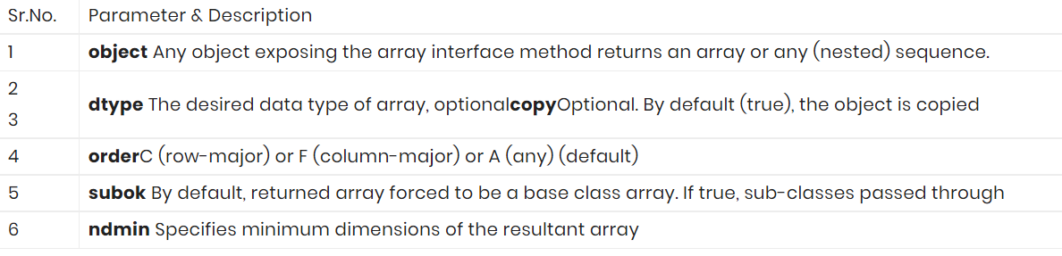
numpy.array(object, dtype = None, copy = True, order = None, subok = False, ndmin = 0)

Slide 6
Creating arrays
Ex1:
#0D array
import numpy as np arr = np.array(42) print(arr)
Output:
42

Slide 7
Ex 2:
#1 dimensional array
import numpy as np
a = np.array([1,2,3])
print a
The output is as follows –
[1, 2, 3]
Ex 3:
# 2 dimensional arrays
import numpy as np
a = np.array([[1, 2], [3, 4]])
print a
The output is as follows −
[[1, 2]
[3, 4]]

Slide 8
Ex 3
#3D array
import numpy as np arr = np.array([[[1, 2, 3], [4, 5, 6]], [[1, 2, 3], [4, 5, 6]]]) print(arr)
Output:
[[[1 2 3]
[4 5 6]]
[[1 2 3]
[4 5 6]]]

Slide 9
#Creating more than 3d array
We can create by using ndmin argument
Ex4
#Create array of 5D
import numpy as np arr = np.array([1, 2, 3, 4], ndmin=5) print(arr)
Output
[[[[[1 2 3 4]]]]]

Slide 10
How to check Dimensions
Using ndim keyword
Ex 5:
a = np.array(42)
b = np.array([1, 2, 3, 4, 5])
print(a.ndim)
print(b.ndim)
Output:
0
1

Slide 11
Checking Shape of the array
Shape is the number of elements in the array
syntax: numpy.shape(array_name) Parameters: Array is passed as a Parameter. Return: A tuple whose elements give the lengths of the corresponding array dimensions.
Ex6:
#find the shape of array
arr1 = npy.array([1, 3, 5, 7])
print(arr1.shape)
Output:
(1,4)

Slide 12
Besides creating an array from a sequence of elements, you can easily create an array filled with 0’s:
>>> np.zeros(2)
Output:
array([0., 0.])
Or an array filled with 1’s:
>>> np.ones(2)
Output:
array([1., 1.])
You can create an array with a range of elements:
>>> np.arange(4)
Output:
array([0, 1, 2, 3])
And even an array that contains a range of evenly spaced intervals. To do this, you will specify the first number, last number, and the step size.
>>> np.arange(2, 9, 2)
Output:
array([2, 4, 6, 8])

Slide 13
Sorting arrays
Sorting an element is simple with np.sort()
arr = np.array([2, 1, 5, 3, 7, 4, 6, 8])
>>> np.sort(arr)
Output:
array([1, 2, 3, 4, 5, 6, 7, 8])
Sorting alphabetical data
import numpy as np arr = np.array(['banana', 'cherry', 'apple']) print(np.sort(arr))
Output:
['apple' 'banana' 'cherry']

Slide 14
Sorting 2D array
import numpy as np arr = np.array([[3, 2, 4], [5, 0, 1]]) print(np.sort(arr))
Output:
[[2 3 4]
[0 1 5]]

Slide 15
Access Array Elements
You can access an array element by referring to its index number.
1.import numpy as np
arr = np.array([1, 2, 3, 4])
print(arr[0])
Output:
1
2.data = np.array([1, 2, 3])
>>> data[1]
2
>>> data[0:2]
array([1, 2])
>>> data[1:]
array([2, 3])
>>> data[-2:]
array([2, 3])

Slide 16
import numpy as np
arr = np.array([[1,2,3,4,5], [6,7,8,9,10]])
print('2nd element on 1st row: ', arr[0, 1])
Output:
2
import numpy as np
arr = np.array([[[1, 2, 3], [4, 5, 6]], [[7, 8, 9], [10, 11, 12]]])
print(arr[0, 1, 2])
Output:
6

Slide 17
import numpy as np
arr = np.array([[1,2,3,4,5], [6,7,8,9,10]])
print('Last element from 2nd dim: ', arr[1, -1])
Output:
10
import numpy as np arr = np.array([1, 2, 3, 4, 5, 6, 7]) print(arr[1:5:2])
Output:
[2,4]

Slide 18
import numpy as np arr = np.array([[1, 2, 3, 4, 5], [6, 7, 8, 9, 10]]) print(arr[1, 1:4]
Output:
[7,8,9]

Slide 19
Searching in array
By using 2 methods
numpy.where()
numpy.searchsorted()
numpy.where:() It returns the indices of elements in an input array where the given condition is satisfied.
numpy.searchsorted(): The function is used to find the indices into a sorted array arr such that, if elements are inserted before the indices, the order of arr would be still preserved

Slide 20
where()
import numpy as np arr = np.array([1, 2, 3, 40, 5, 40, 40]) x = np.where(arr == 40) print(x)
Output:
(array([3, 5, 6],)
import numpy as np
arr = np.array([1, 2, 3, 4, 5, 6, 7, 8])
x = np.where(arr%4 == 0)
print(x)
Output:
(array([ 3, 7]),)

Slide 21
Searchsorted()
import numpy as np arr = np.array([6, 7, 9, 19]) x = np.searchsorted(arr, 8) print(x)
Output:
2
np.searchsorted([1,2,3,4,5], 3)
Output:2
>>> np.searchsorted([1,2,3,4,5], 3, side='right')
Output:3
>>> np.searchsorted([1,2,3,4,5], [-10, 10, 2, 3]) Output:array([0, 5, 1, 2])

Slide 22
Reshaping array: reshape()
import numpy as np arr = np.array([1, 2, 3, 4, 5, 6, 7, 8, 9, 10, 11, 12]) newarr = arr.reshape(4, 3) print(newarr)
Output:
[[ 1 2 3]
[ 4 5 6]
[ 7 8 9]
[10 11 12]]
Convert the array into a 1D array:(-1)
import numpy as np arr = np.array([[1, 2, 3], [4, 5, 6]]) newarr = arr.reshape(-1) print(newarr)
Output:[1 2 3 4 5 6]

Slide 23
Filtering array: filter()
In NumPy, you filter an array using a boolean index list.
If the value at an index is True that element is contained in the filtered array, if the value at that index is False that element is excluded from the filtered array.
import numpy as np arr = np.array([41, 42, 43, 44]) x = [True, False, True, False] newarr = arr[x] print(newarr)
Output:[41 43]

Slide 24
seq = [0, 1, 2, 3, 5, 8, 13]
# result contains odd numbers of the list
result = filter(lambda x: x % 2 != 0, seq)
print(list(result))
# result contains even numbers of the list
result = filter(lambda x: x % 2 == 0, seq)
print(list(result))
Output:
[1, 3, 5, 13]
[0, 2, 8]

Slide 25
Joining array:
concatenate(): It simply joins 2 arrays.
stack():Stacking is same as concatenation, the only difference is that stacking is done along a new axis.
hstack(): this joins along rows.
vstack() :this joins along columns.
dstack():this is to stack along height, which is the same as depth.

Slide 26
Concatenate()
a=np.arange(6).reshape(2,3)
Print a
Output:([[0,1,2]
[3,4,5]])
b=np.arange(7,13).reshape(2,3
Print b
Output: ([[7,8,9]
[10,11,12]])
np.concatenate((a,b))
Output:
Array([[0,1,2]
[3,4,5]
[7,8,9]
[10,11,12]])

Slide 27
np.concatenate((a,b),axis=1)
Output:
Array([[0,1,2 ,7,8,9],
[3,4,5,10,11,12]])
np.stack((a,b))
Output:([[[0,1,2]
[3,4,5]],
[[7,8,9]
[10,11,12]]])

Slide 28
vstack()
np.vstack((a,b))
Output:Array([[0,1,2],
[3,4,5],
[7,8,9],
[10,11,12]])
np.hstack((a,b))
Output:Array([[0,1,2, 7,8,9],
[3,4,5, 10,11,12]])
np.dstack((a,b))
Output: ([[[0,7],
[1,8],
[2,9]],
[3,10],
[4,11],
[5,12]]])

Slide 29

Pandas Basics

Slide 30
PANDAS
Pandas is an open source Python package that is most widely used for data science/data analysis
It works with large data sets
The name "Pandas" has a reference to both "Panel Data", and "Python Data Analysis" and was created by Wes McKinney in 2008.
It uses 3 Datastructures 1.Series
2. Data frames 3. Panel
Series: deals with 1D array
Data frames: deals with 2D array
Panel:deals with multi dimensions

Slide 31
Importing Pandas
import pandas as pd
Syntax: pd.Series(data,index)
Syntax:pd.DataFrame(data)
Syntax:pd.Panel(data,major axis,minor axis,dtype)

Slide 32
Creating series
Empty series
Series using arrays
Series using lists
Series using dictionary
Creating empty series
import pandas as pd
S=pd.Series( )
Series( ( ) )
Creating series using array
a=np.array([10,20,30,40])
Output:0 10
1 20
2 30
3 40

Slide 33
import pandas as pd a = [10, 70, 20] myvar = pd.Series(a, index = ["x", "y", "z"]) print(myvar)
Output:x 10
y 70
z 20
Accessing by referring variables
import pandas as pd
a = [10, 70, 20]
myvar = pd.Series(a, index = ["x", "y", "z"])
print(myvar["y"])
Output:70

Slide 34
Creating series using lists
L=[10,20,30,40]
pd.Series(L)
Output:0 10
1 20
2 30
3 40
Series using dictionary
import pandas as pd
sales = {"day1": 42, "day2": 38, "day3": 39}
myvar = pd.Series(sales)
print(myvar)
Output:day1 42
day2 38
day3 39

Slide 35
Creating Data frames
import pandas as pd data = { "calories": [420, 380, 390], "duration": [50, 40, 45] } myvar = pd.DataFrame(data) print(myvar)
Output: calories duration
0 420 50
1 380 40
2 390 45
Accesing rows:by using loc keyword
print(df.loc[0])
Output:calories 420
duration 50
print(df.loc[[0, 1]])
Output: calories duration
0 420 50
1 380 40

Slide 36
import pandas as pd sales = { “price": [120, 280, 390], “pieces": [50, 40, 45] } myvar = pd.DataFrame(data,index=["day1", "day2", "day3"]) print(myvar)
print(myvar.loc["day2"])
Output:calories 280
duration 40

Slide 37
Loading Files Into a DataFrame
Loading data from excel file: read_excel
Loading data from CSV file: read_csv
Loading excel file
import pandas as pd
Df=pd.read_excel(“path”)
Loading csv file
import pandas as pd
Df=pd.read_csv(“path”)

Slide 38
import pandas as pd df = pd.read_csv('data.csv') print(df.to_string())
Output: it will print entire data
Print the DataFrame without the to_string() method:
import pandas as pd
df = pd.read_csv('data.csv')
print(df)
Output:it will print only starting 5 rows and ending 5 rows

Slide 39
Reading json
Big data sets are often stored, or extracted as JSON.
import pandas as pd
df = pd.read_json('data.json')
print(df.to_string())
Output:prints entire data

Slide 40
Dictionary as JSON
import pandas as pd data = { "Duration":{ "0":60, "1":60, "2":60, "3":45, "4":45, "5":60 }, "Pulse":{ "0":110, "1":117, "2":103, "3":109, "4":117, "5":102 }, "Maxpulse":{ "0":130, "1":145, "2":135, "3":175, "4":148, "5":127 }, "Calories":{ "0":409, "1":479, "2":340, "3":282, "4":406, "5":300 } } df = pd.DataFrame(data) print(df)

Slide 41
Output:
Duration Pulse Maxpulse Calories
0 60 110 130 409.
1 60 117 145 479.0
2 60 103 135 340.0
3 45 109 175 282.4
4 45 117 148 406.0
5 60 102 127 300.5

Slide 42
Viewing the Data : slicing
Head( )
tail( )
One of the most used method for getting a quick overview of the top rows, is the head() method.
One of the most used method for getting a quick overview of the bottom rows, is the tail() method.
import pandas as pd df = pd.read_csv('data.csv') print(df.head(10))
Output:returns top 10 rows
print(df.head())
Output:returns only 5 top rows
import pandas as pd df = pd.read_csv('data.csv') print(df.tail(10))
Output:returns 10 bottom rows
print(df.tail())
Output:returns only 5 bottom rows

Slide 43
Other built in operations in dataframes
Df.shape:returns no of rows and columns
Df.loc( ):returns rows
Df.loc[df[col name]==‘val’]:returns particular row with the given condition
Df.columns:returns the names of coulmns
Df.[‘col name’].head():returns particular column
Df.[‘col name’].tail( ):
Df.[start index:end index:step size]

Slide 44
Handling missing data:handling null values
Sometimes our dataset contain some empty cells and those cells are known as null values
WHY TO HANDLE NULL VALUES
Because we cant provide null values to our machine learning model

Slide 45
What can we do
Either fill the null values with some values
Drop such values
Either replace them

Slide 46
isnull( ): it checks the data and returns in the form of Boolean values
isnull( ).sum( ):it returns the number of null values in the particular rows or coulumns in the data set.
isnull( ).sum( ).sum( ):it returns total number of null values in data set.

Slide 47
Filling null values:
df.fillna(value=‘ ’)
df.fillna(method=‘pad’):filling the previous value
df.fillna(method=‘bfill’):filling the next value
df.fillna(method=‘pad’, axis=1):
df.fillna(method=‘bfill’, axis=1)
df.fillna({‘name’: ‘xyz’, ‘rno’: ‘123’}) :filling different values in ull in different columns
df.fillna(value=df[‘name’].mean( )):filling with the mean value of that column
df.fillna(value=df[‘name’].min( )):filling with the minimum value of that column
df.fillna(value=df[‘name’].max( )):filling with the maximum value of that column

Slide 48
Dropping null values:dropna( )
df.dropna( ):it drops all the null values
df.dropna(how=‘all’):it drops only if all the values of that column are null
df.dropna(how=‘any’):it drops only if any of the values of that column are null

Slide 49
Replacing null values:replace( )
Df.replace(to_replace=np.nan,value=1234):
it replaces null values into specified value
Df.replace(to_replace=3.0,value=4.0):
it replaces any values into specified value

Slide 50
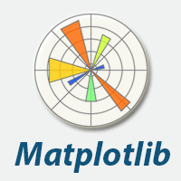
MATPLOTLIB BASICS

Slide 51
Matplotlib is an amazing visualization library in Python for 2D plots of arrays
Matplotlib was created by John D. Hunter.
Matplotlib is open source and we can use it freely.
Module we are going to use is PYPLOT
The alias we are using for Pyplot is plt
Matplotlib consists of several plots like line, bar, scatter, histogram etc.

Slide 52
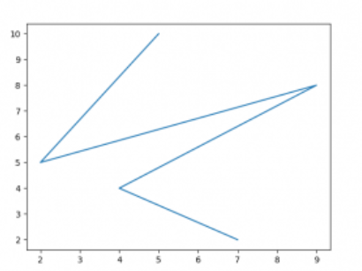
Basic plots: line plot
# importing matplotlib module from matplotlib import pyplot as plt # x-axis values x = [5, 2, 9, 4, 7] # Y-axis values y = [10, 5, 8, 4, 2] # Function to plot plt.plot(x,y) # function to show the plot plt.show() Output:

Slide 53
Plotting 2 or more lines in same graph
import matplotlib.pyplot as plt
# line 1 points
x1 = [1,2,3]
y1 = [2,4,1]
# plotting the line 1 points
plt.plot(x1, y1, label = "line 1")
# line 2 points
x2 = [1,2,3]
y2 = [4,1,3]
# plotting the line 2 points
plt.plot(x2, y2, label = "line 2")
# naming the x axis
plt.xlabel('x - axis')
# naming the y axis
plt.ylabel('y - axis')
# giving a title to my graph
plt.title('Two lines on same graph!')
# show a legend on the plot
plt.legend()
# function to show the plot
plt.show()

Slide 54
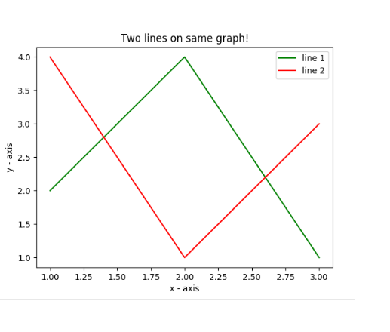
Output:

Slide 55
Bar graph
import matplotlib.pyplot as plt
# x-coordinates of left sides of bars
left = [1, 2, 3, 4, 5]
# heights of bars
height = [10, 24, 36, 40, 5]
# labels for bars
tick_label = ['one', 'two', 'three', 'four', 'five']
# plotting a bar chart
plt.bar(left, height, tick_label = tick_label,
width = 0.8, color = ['red', 'green'])
# naming the x-axis
plt.xlabel('x - axis')
# naming the y-axis
plt.ylabel('y - axis')
# plot title
plt.title('My bar chart!')
# function to show the plot
plt.show()

Slide 56
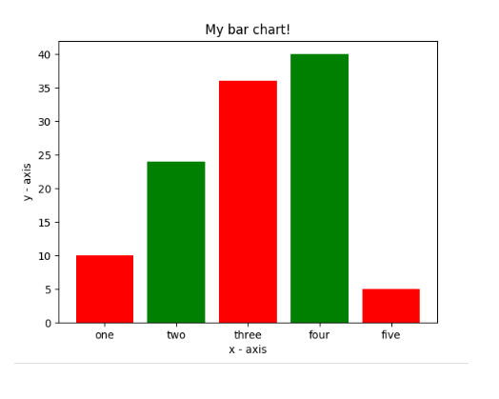
output

Slide 57
Scatter graph
import matplotlib.pyplot as plt
# x-axis values
x = [1,2,3,4,5,6,7,8,9,10]
# y-axis values
y = [2,4,5,7,6,8,9,11,12,12]
# plotting points as a scatter plot
plt.scatter(x, y, label= "stars", color= "green",
marker= "*", s=30)
# x-axis label
plt.xlabel('x - axis')
# frequency label
plt.ylabel('y - axis')
# plot title
plt.title('My scatter plot!')
# showing legend
plt.legend()
# function to show the plot
plt.show()

Slide 58
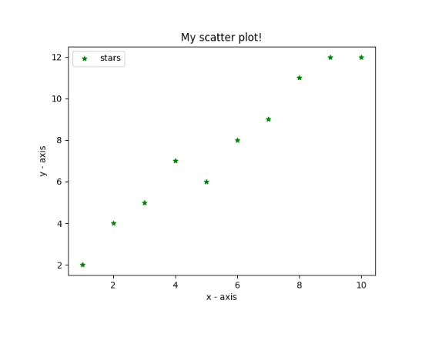
output

Slide 59
Pie chart
import matplotlib.pyplot as plt
# defining labels
activities = ['eat', 'sleep', 'work', 'play']
# portion covered by each label
slices = [3, 7, 8, 6]
# color for each label
colors = ['r', 'y', 'g', 'b']
# plotting the pie chart
plt.pie(slices, labels = activities, colors=colors,
startangle=90, shadow = True, explode = (0, 0, 0.1, 0),
radius = 1.2, autopct = '%1.1f%%')
# plotting legend
plt.legend()
# showing the plot
plt.show()

Slide 60
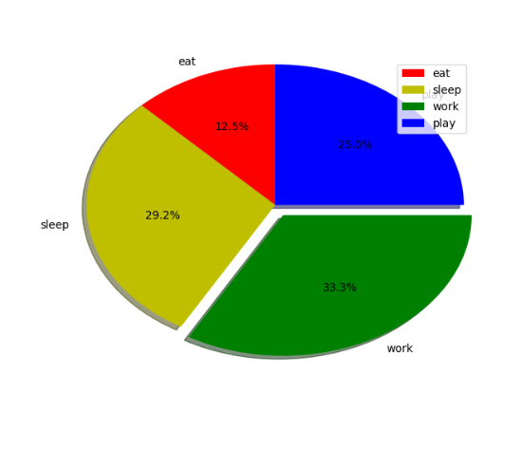
output
Here, we plot a pie chart by using plt.pie() method.
First of all, we define the labels using a list called activities.
Then, a portion of each label can be defined using another list called slices.
Color for each label is defined using a list called colors.
shadow = True will show a shadow beneath each label in pie chart.
startangle rotates the start of the pie chart by given degrees counterclockwise from the x-axis.
explode is used to set the fraction of radius with which we offset each wedge.
autopct is used to format the value of each label. Here, we have set it to show the percentage value only upto 1 decimal place.

Slide 61
histogram
from matplotlib import pyplot as plt
import numpy as np
# Creating dataset
a = np.array([22, 87, 5, 43, 56,
73, 55, 54, 11,
20, 51, 5, 79, 31,
27])
# Creating histogram
fig, ax = plt.subplots(figsize =(10, 7))
ax.hist(a, bins = [0, 25, 50, 75, 100])
# Show plot
plt.show()

Slide 62
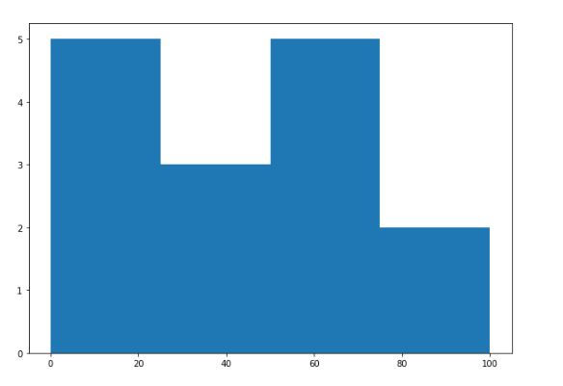
output

Slide 63
Plotting graph of given equation
# importing the required modules
import matplotlib.pyplot as plt
import numpy as np
# setting the x - coordinates
x = np.arange(0, 2*(np.pi), 0.1)
# setting the corresponding y - coordinates
y = np.sin(x)
# plotting the points
plt.plot(x, y)
# function to show the plot
plt.show()

Slide 64
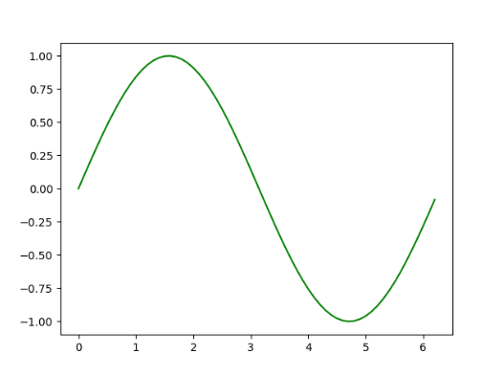
output
To set the x-axis values, we use the np.arange() method in which the first two arguments are for range and the third one for step-wise increment. The result is a NumPy array.
To get corresponding y-axis values, we simply use the predefined np.sin() method on the NumPy array.
Finally, we plot the points by passing x and y arrays to the plt.plot() function.

Slide 65
Assignment
In this assignment you'll train several models and evaluate how effectively they predict instances of fraud.
Ref: https://github.com/amirkeren/applied-machine-learning-in-python/blob/master/Assignment%2B3.ipynb

Slide 66
Code for the presentation can be found here
Refer Readme.md of github repository for list of assignments:
https://github.com/tahirmirji/ai_with_python_keonics

Slide 67
Thank You

